Slide 1
Space Invaders
Group: Space Crusaders
Members: Phuong Tran, Noah Markowitz, Yiran Yin, Arthur Savage, Benjamin Hsu
BU ENG EC327 Fall 2022

Slide 2
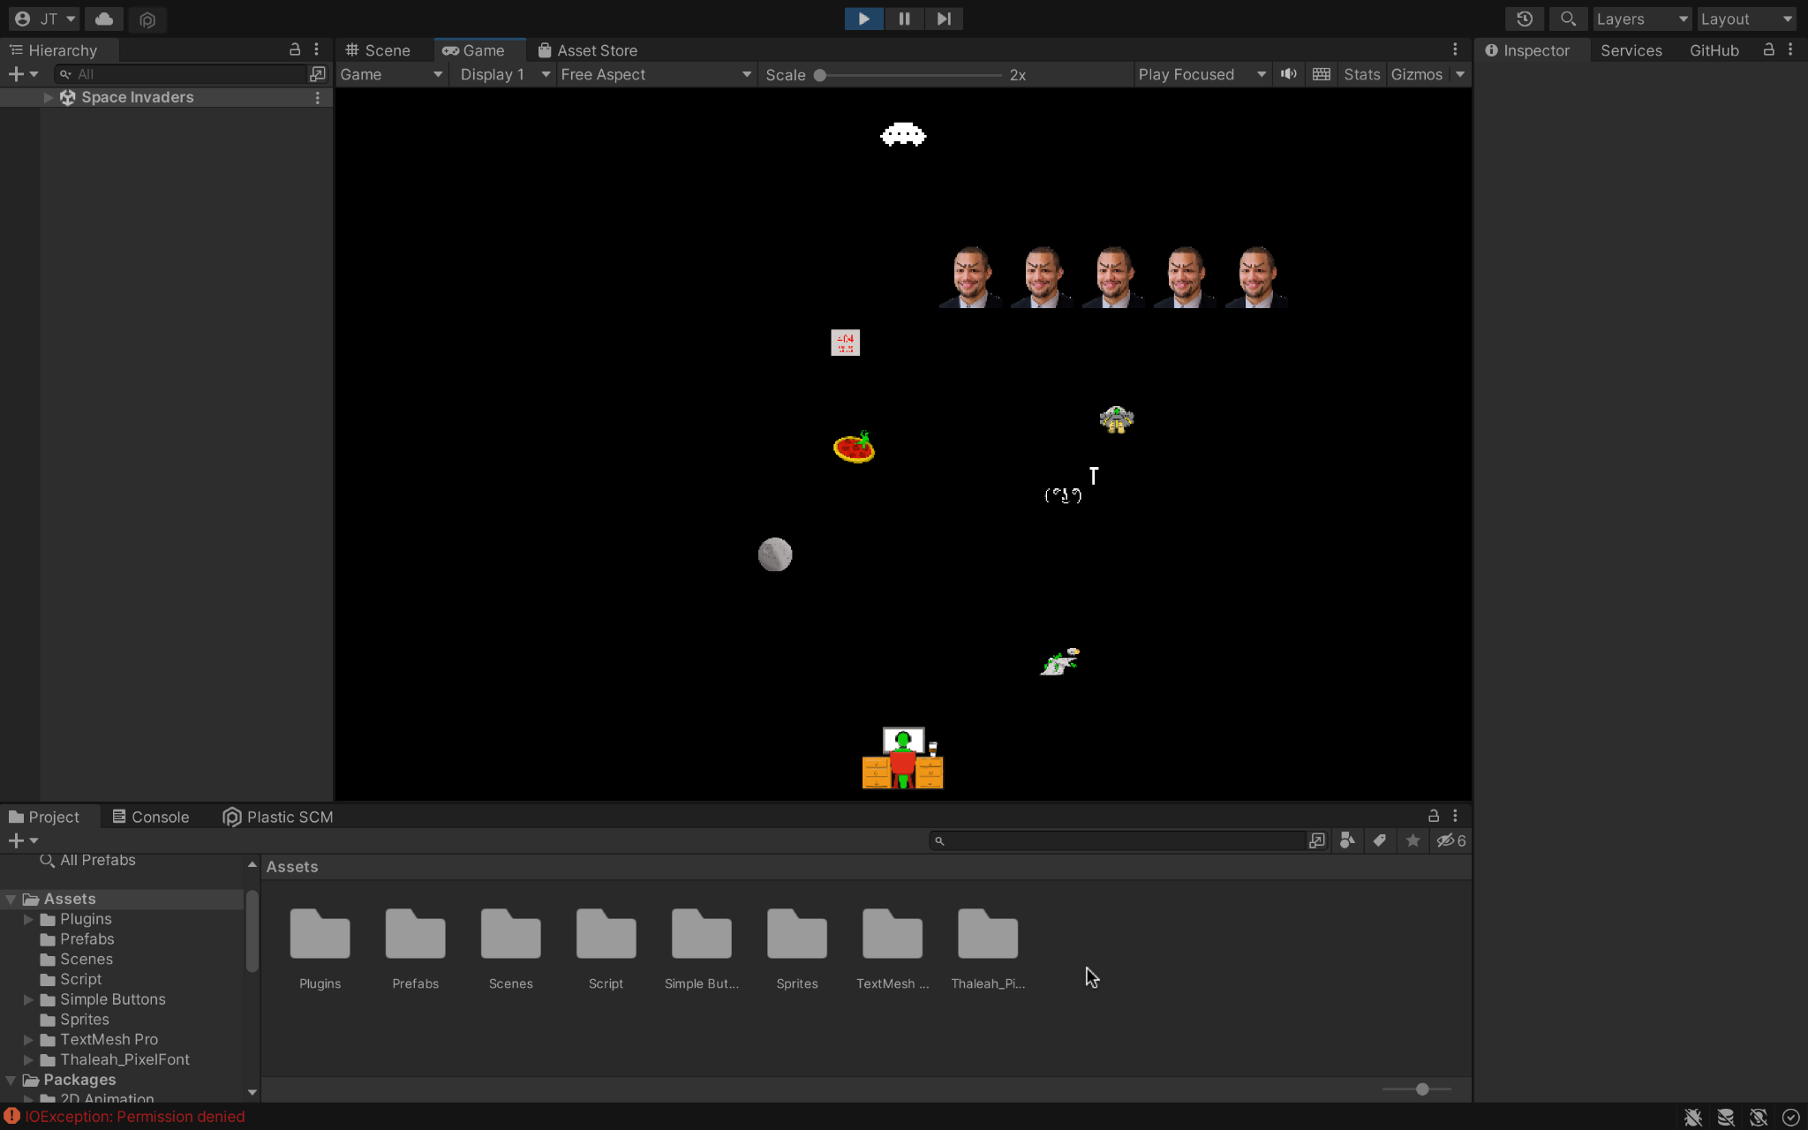
Unity - Game Development Platform
Unity Editor release version: 2021.3.14f1
Unity Plastic SCM: a version control and source code management tool, to collaborate.

Slide 3
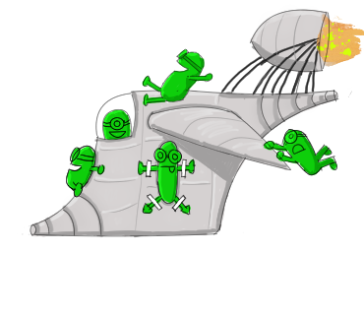

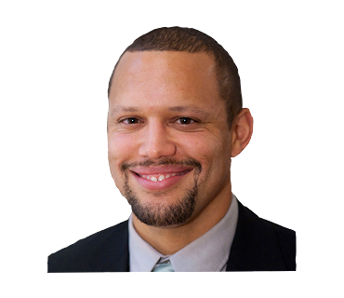
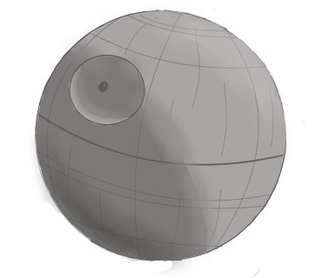
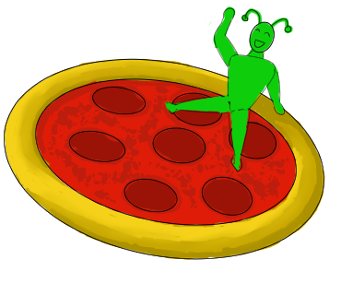
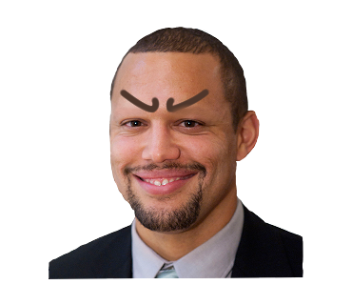
Hand Drawn Sprites (in folder “Sprites”)

Slide 4
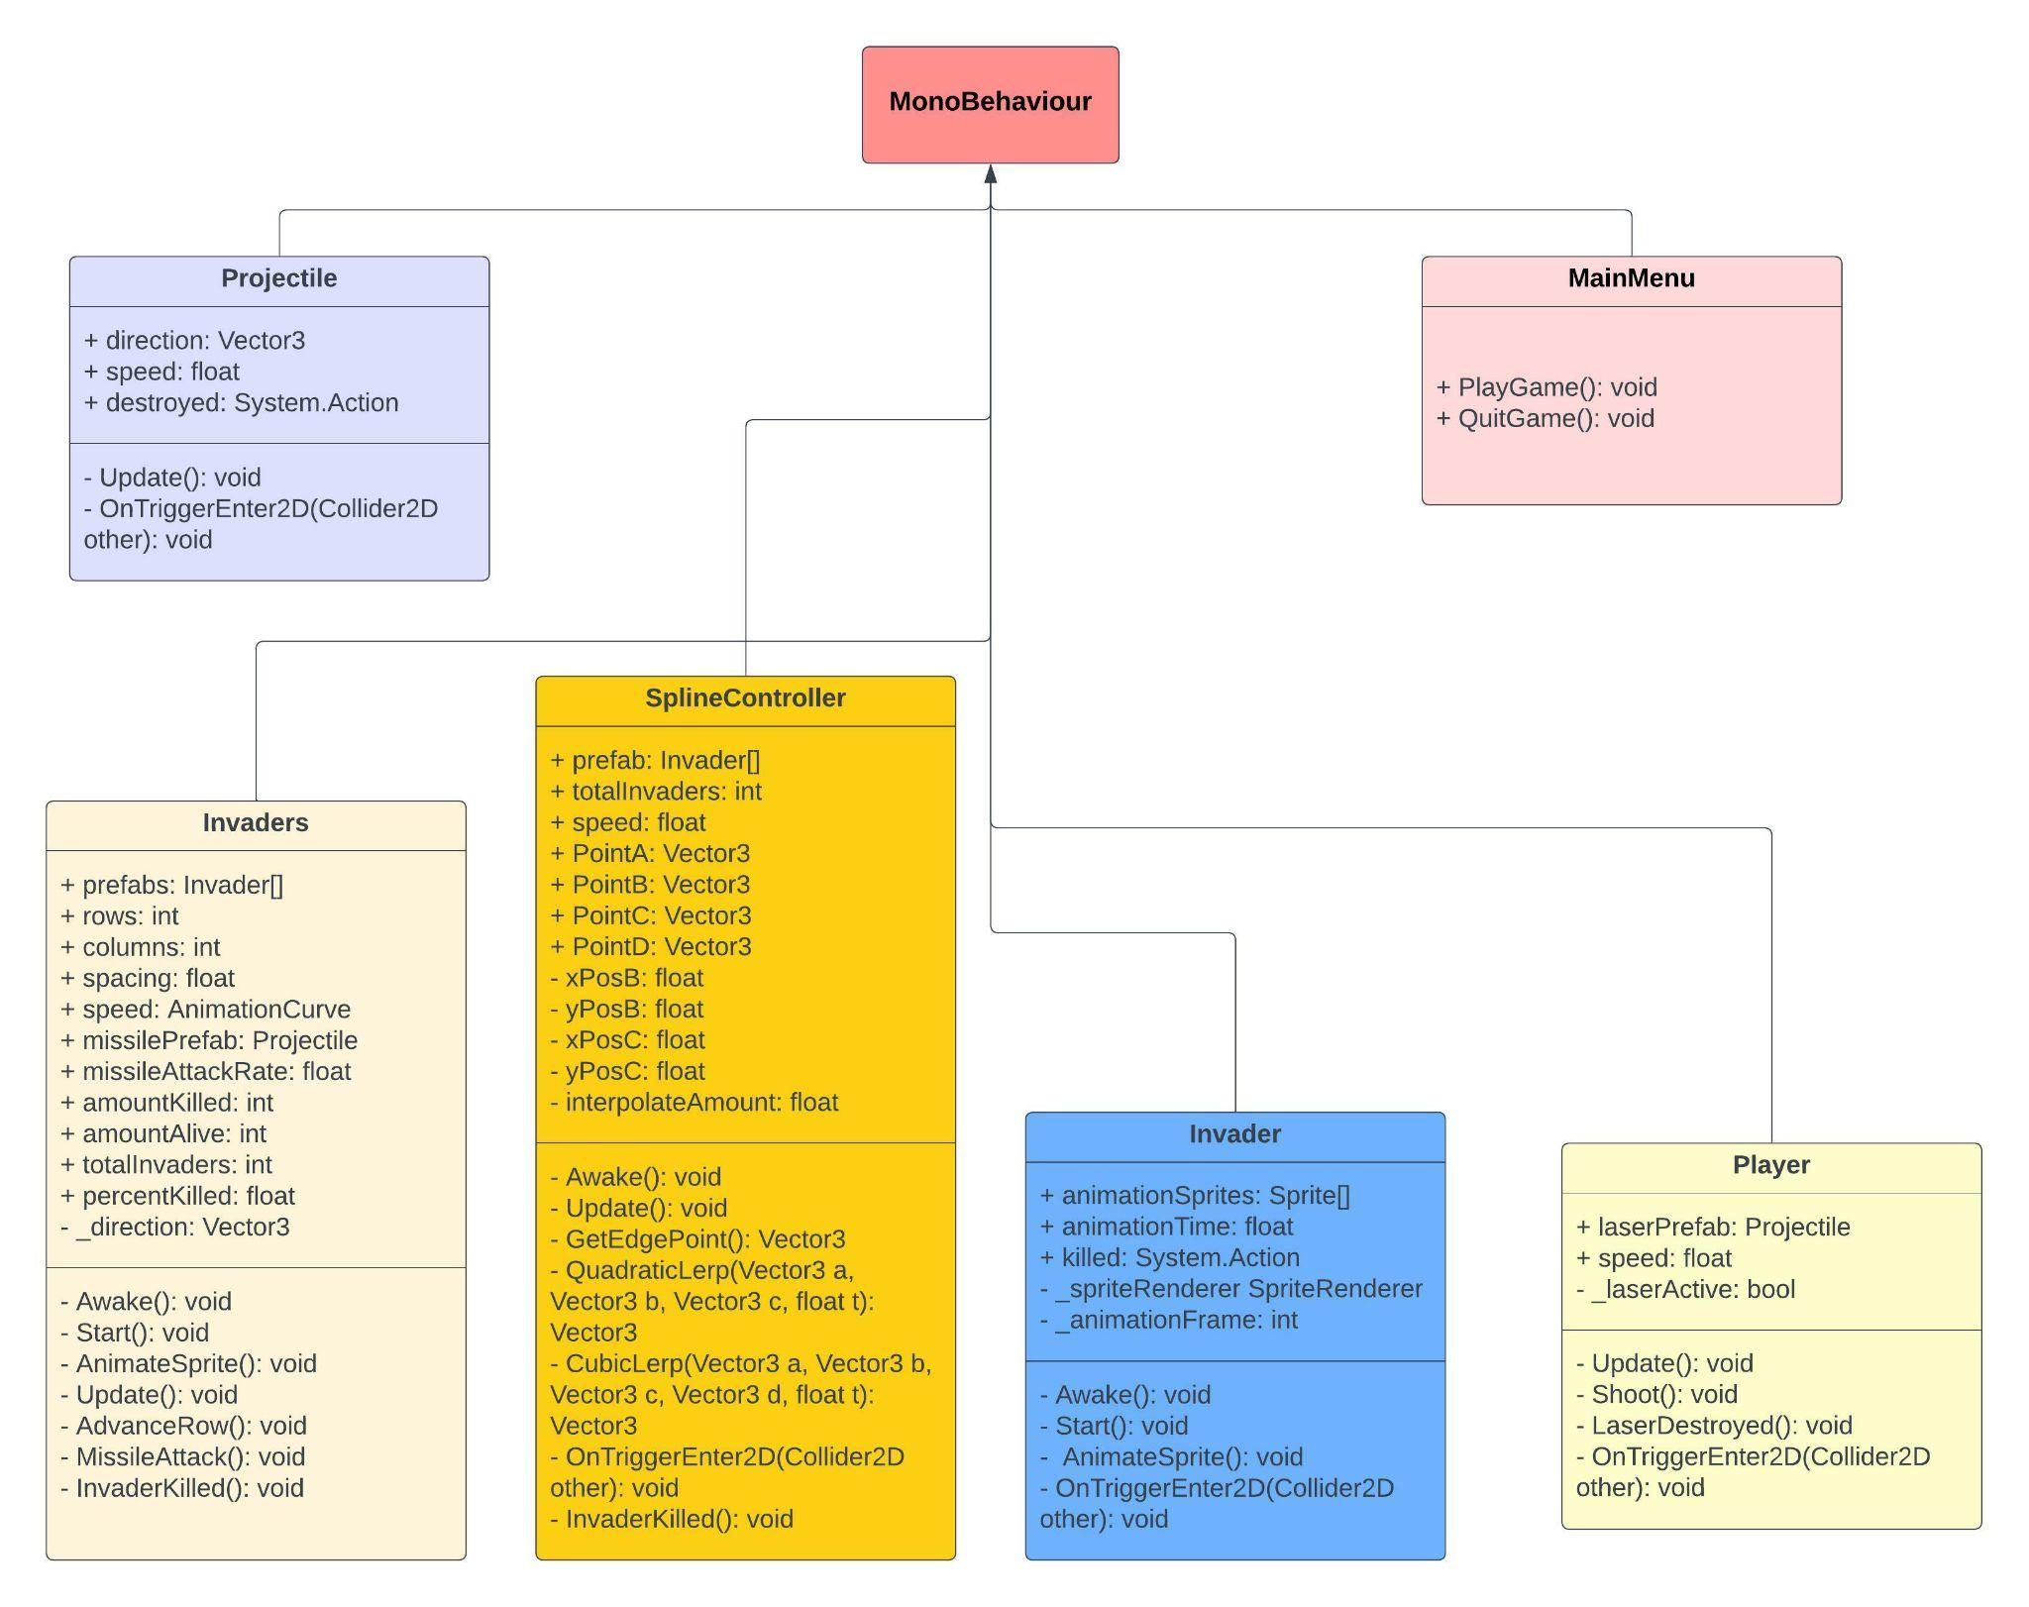
UML Diagram

Slide 5
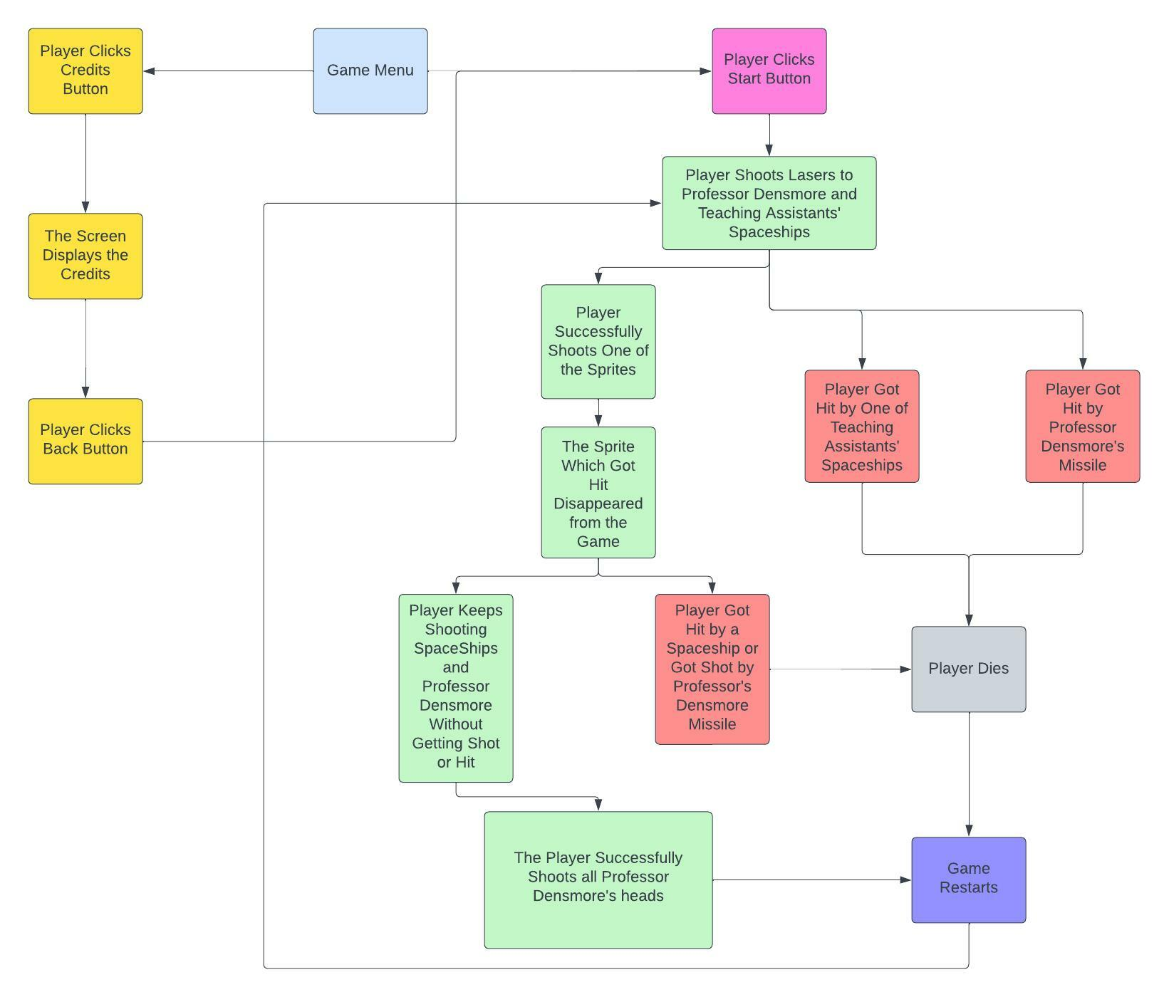
Block Diagram of Game Process

Slide 6
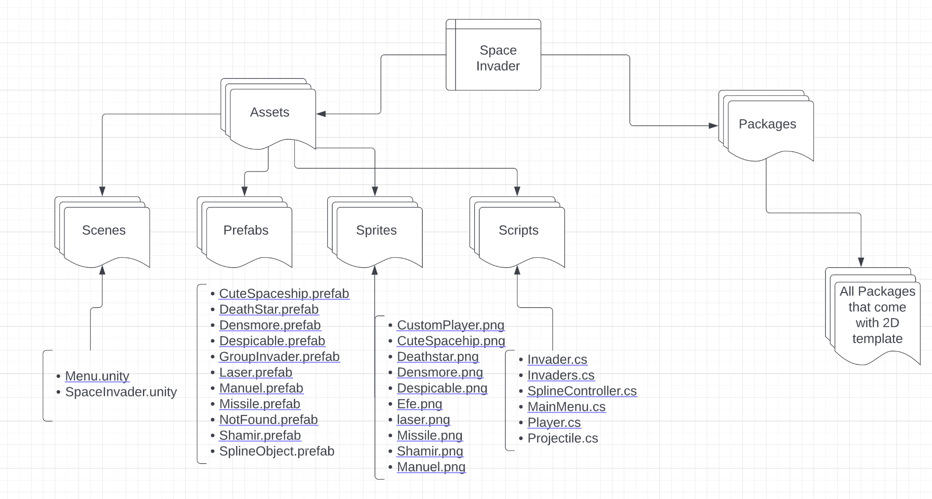
Code Organization in File Structure

Slide 7
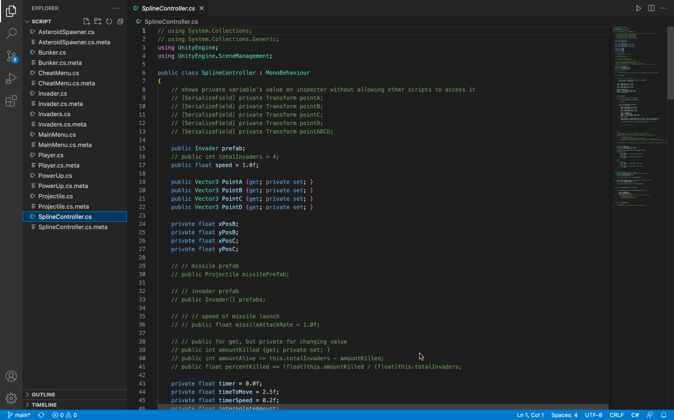

Slide 8
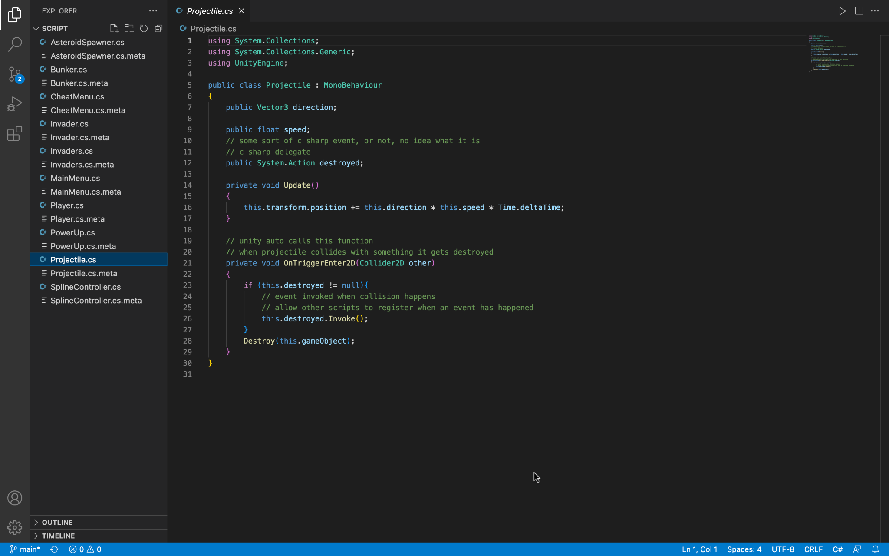

Slide 9
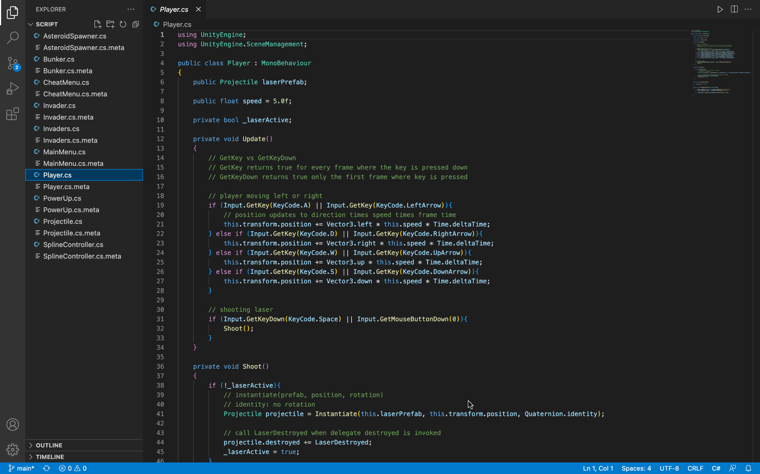

Slide 10
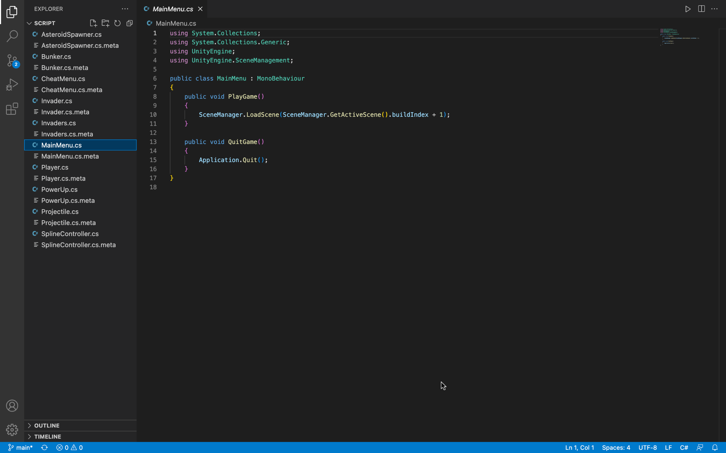

Slide 11
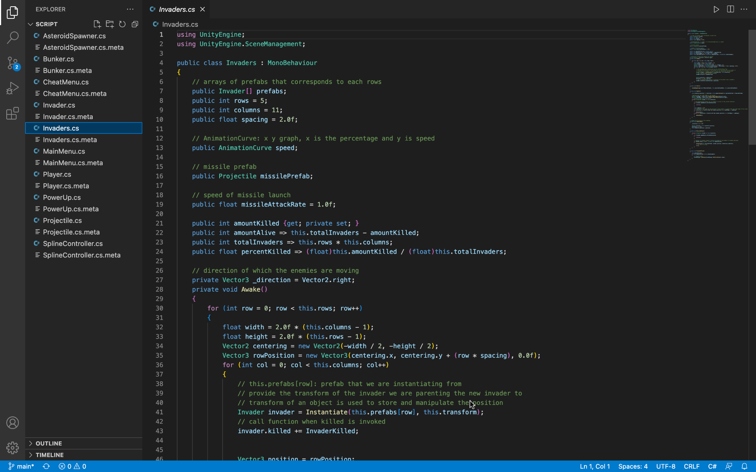

Slide 12
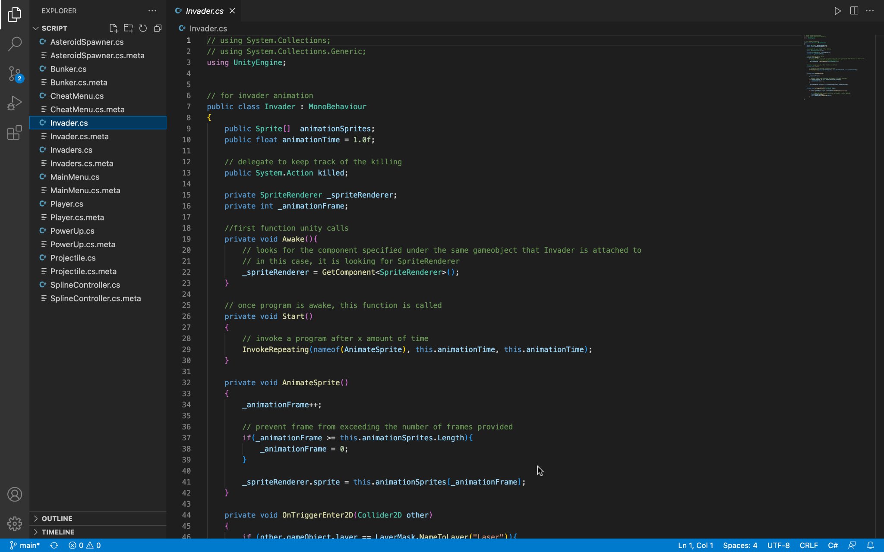

Slide 13
How Users Interact with the Project
Controls:
‘WASD’ / ‘ARROW KEYS’ - Move Player Sprite
‘SPACE KEY’ / LEFT MOUSE BUTTON’ - Shoot Laser
Win Condition:
Annihilate all Densmore heads to win the game
The game will restart if the player sprite collides with missiles or the staff

Slide 14
Thank You for a Wonderful Semester! 😊

